Slide 1

Lab 03 timers
Prof. Davide Brunelli
Dept. of Industrial Engineering – DII
University of Trento, Italy
davide.brunelli@unitn.it

Slide 2
TIMERS

Slide 3
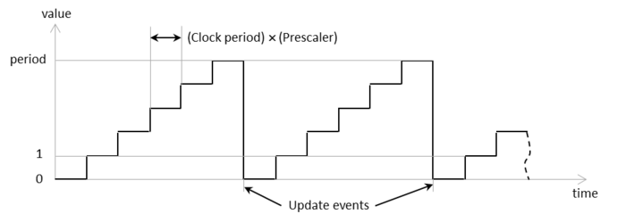
Timers
A hardware timer is essentially an independent counter that counts from zero to its maximum value at a given speed and generates various events. It runs in the background independently from your C/C++ program and its value typically follows the sequence depicted below:
It is basically a global variable (timer counter) that increments (or decrements) on the basis of a programmable clock source
3

Slide 4
Timers
The hardware of a timer is composed of three basic programmable parts:
The clock source: the circuit that generates the clock tick for the timer
The time base: the circuit that derives the time granularity from the clock source and contains the timer counter variable
The slave circuits: provide additional functions (pulse measure, signal generation, etc.) by exploiting the timer variable
4

Slide 5
Timers
The STM32 MCU offers up to 11 different timer/counters with the following features:
Clock selection (internal, external, other)
16/32-bit counter resolution
Programmable prescaler
Four independent channels configurable as:
Input Capture
Output Compare
PWM Mode
One-pulse Output
Interrupt generation on the basis of the various events that can occur
5

Slide 6
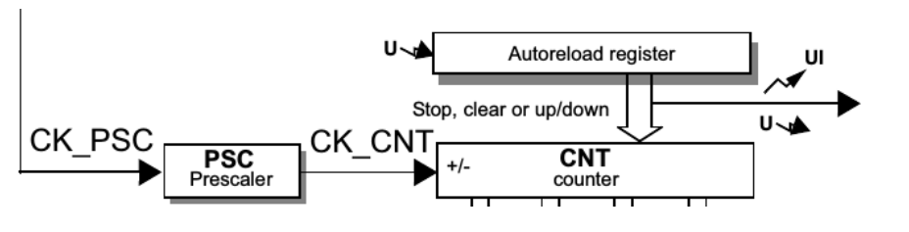
Timers
Counting is handled in the time-base by the following registers:
TIMx->PSC: the prescaler register; it directly specifies the division factor
TIMx->CNT: the counter register; it holds the counter value and increments (or decrements) it according to the input clock
TIMx->ARR: the auto-reload register; CNT counts from 0 to ARR, then CNT is set to 0 again
When CNT is reloaded, an update event is generated (the “U” in figure) which can trigger an interrupt generation
6

Slide 7
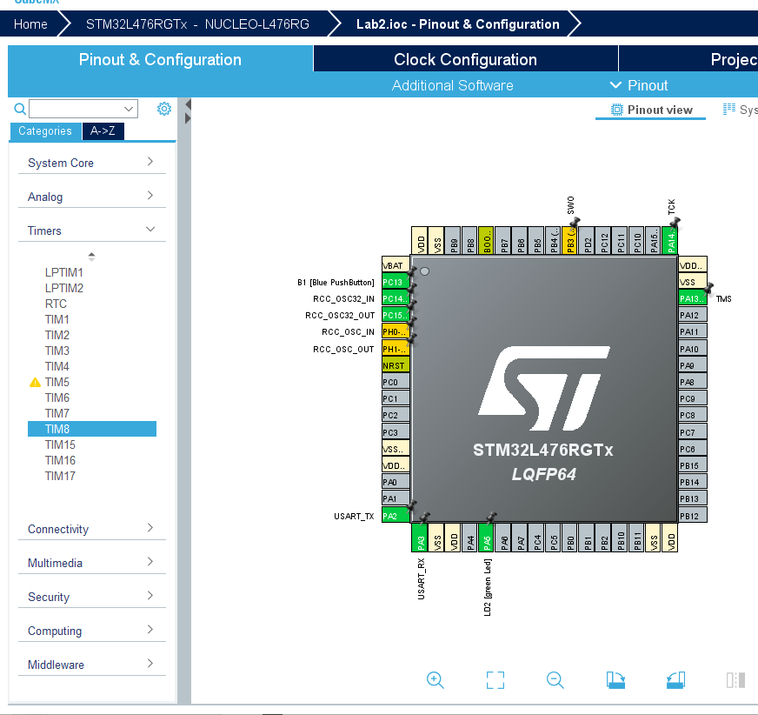
STM32 Timers
The STM32 embeds multiple timers providing timing resources for software or hardware tasks.
The software tasks mainly consist of providing time bases, timeout event generation and time-triggers.
The hardware tasks are related to I/Os: the timers can generate waveforms on their outputs, measure incoming signal parameters and react to external events on their inputs.
7

Slide 8
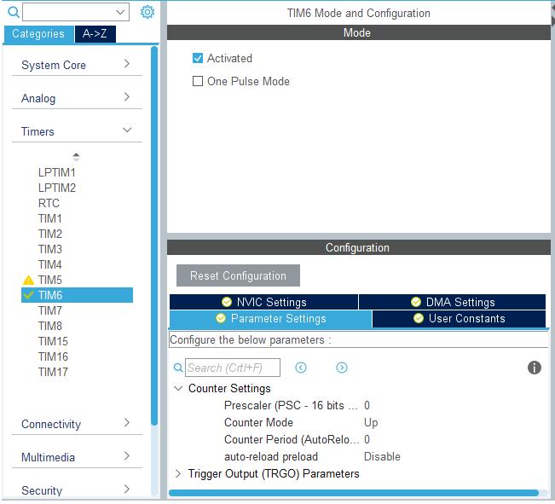
STM32 Timers
We will use TIM6 for our board.
TIM6 is a simple Timer acting as a Counter. It just counts the clock cycles up to the maximum value set and then reset.
8

Slide 9
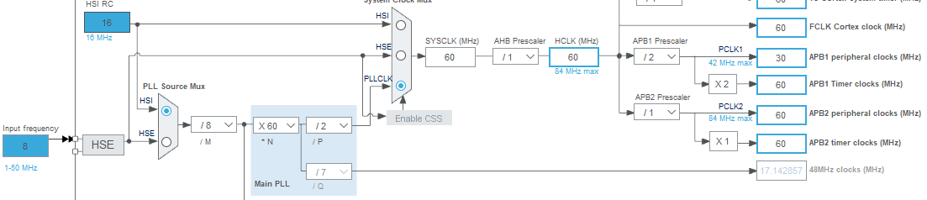
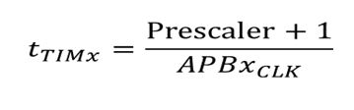
STM32 Timers
Timer tick time (or timer resolution) is base on APBx clock. It can be scaled using a 16 Bit prescaler. We can modify the base clock, to simplify the pre-scaler division.
9

Slide 10
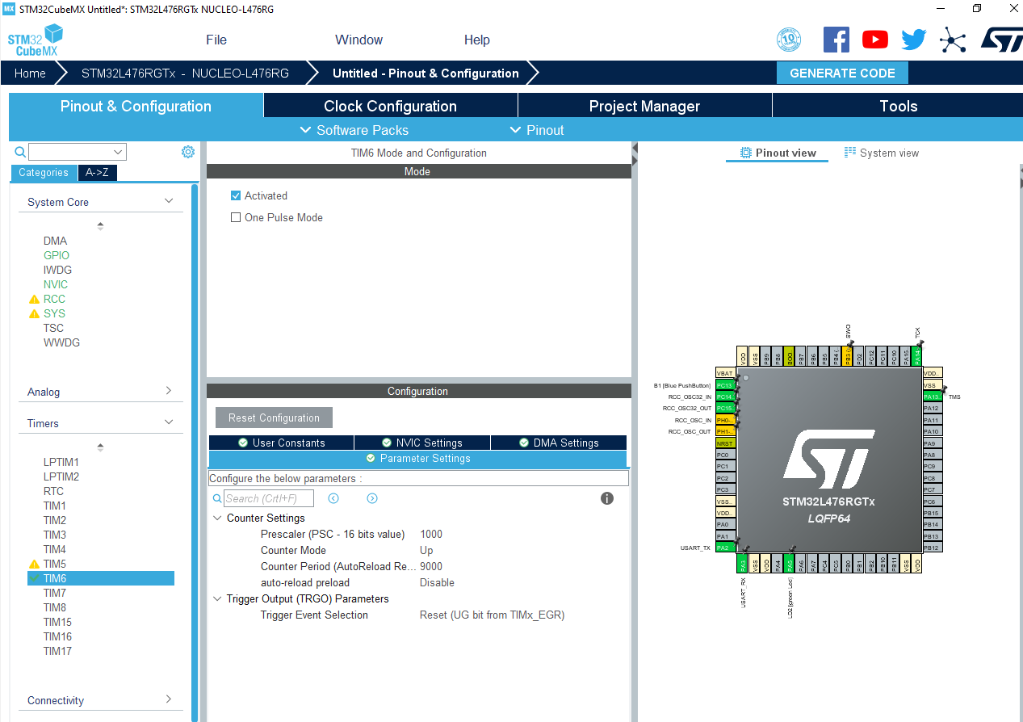


STM32 Timers
10

Slide 11
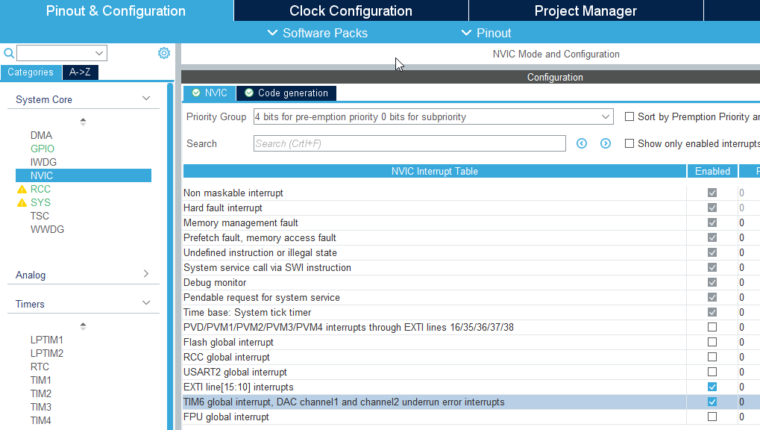
STM32 Timers – Interrupt
We can activate the interrupt using the NVIC configuration tab in CubeMX
11

Slide 12
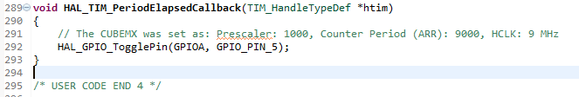

STM32 Timers – Interrupt
Once the timer has reached its counting period, an interrupt will be fired. Using the proper callback function we can create timed tasks (like the blinking of a LED)
After the Peripheral Initializations, remember to start TIM6 In Interrupt Mode.
12

Slide 13
STM32 Timers – Resources
General-purpose timer cookbook for STM32 microcontrollers
https://www.stmicroelectronics.com.cn/content/ccc/resource/technical/document/application_note/group0/91/01/84/3f/7c/67/41/3f/DM00236305/files/DM00236305.pdf/jcr:content/translations/en.DM00236305.pdf
STM32L4 Timers
https://www.st.com/content/ccc/resource/training/technical/product_training/c4/1b/56/83/3a/a1/47/64/STM32L4_WDG_TIMERS_GPTIM.pdf/files/STM32L4_WDG_TIMERS_GPTIM.pdf/jcr:content/translations/en.STM32L4_WDG_TIMERS_GPTIM.pdf
13

Slide 14
TOGGLE THE LED
USING A TIMER

Slide 15
TOGGLE THE LED USING A TIMER
Use the previously configured timer to toggle the green LED every 1 second.
Use CubeMX to configure a simple timer
Configure the board clock to provide an APB clock equal to 60 MHz
If needed, pre-scale the clock to a suitable frequency for the timer
Set the timer counting period
Start the timer using the blue button
Using the interrupt callback, toggle the green LED
15

Slide 16
CHANGE THE TIMER COUNTING PERIOD

Slide 17
CHANGE THE TIMER COUNTING PERIOD
Using an interrupt generated by an external input, cycle the timer counting period between 0 – 0.25s – 0.5s – 1s – 2s
Use CubeMX to configure a simple timer
Configure the board clock to provide an APB clock equal to 60 MHz
If needed, pre-scale the clock to a suitable frequency for the timer
Set the timer counting period
Using the interrupt callback, cycle the counting period of the configured timer by updating the relative register.
17

